Slide 1

Title: Student Internship Management System
Team Members:
Venkata Shashankar Chennu
Parimalla Pokuri
Anusha Poreddy
Manikanta Arumilli
Sai Krishna Gadde
Client & Mentor: Dr. Chandra Mouli Kotteti
Sec No: 03
Team No: 04
Presenter: Venkata Shashank Chennu
Page: 1

Slide 2


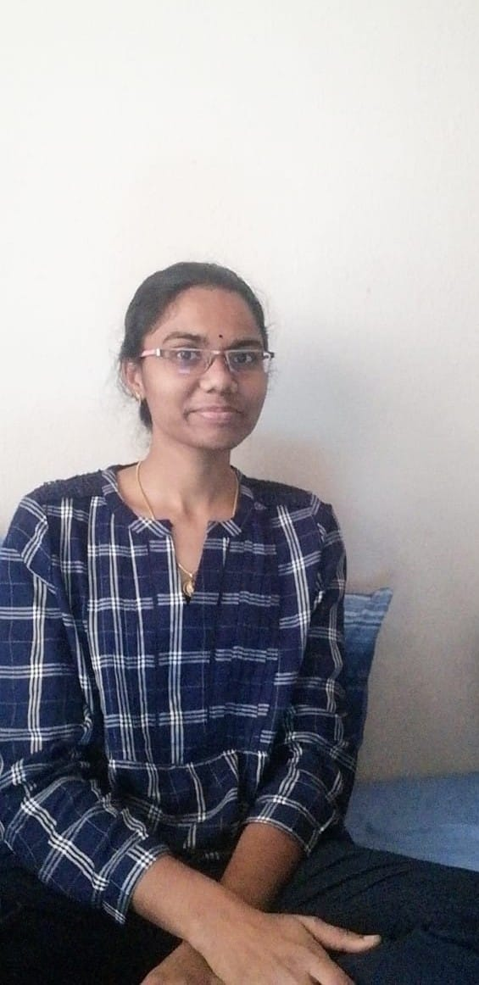

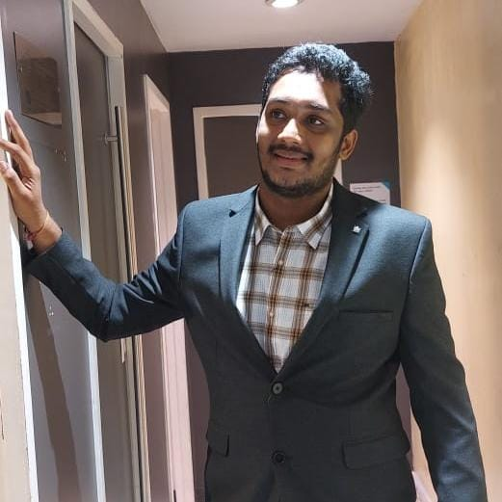

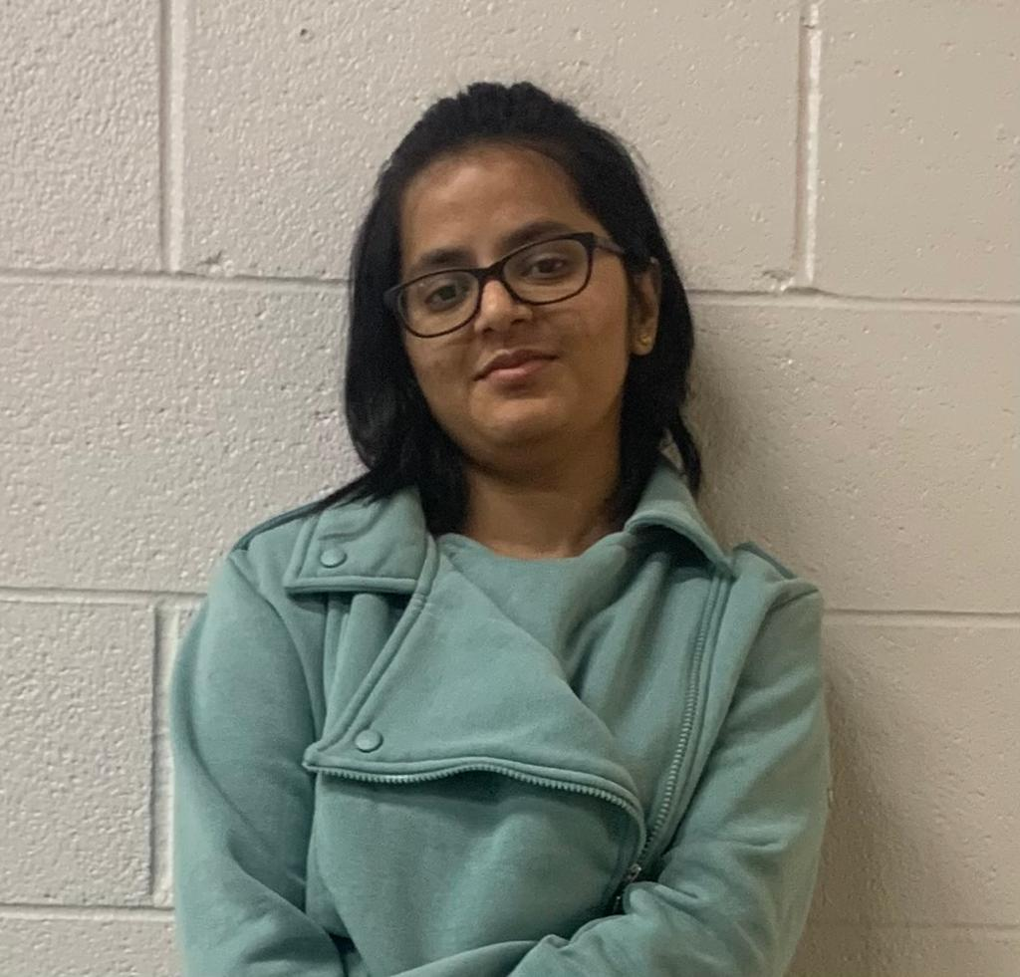
TEAM - 04
TEAM-04
VENKATA SHASHANKAR CHENNU
PARIMALLA POKURI
MANIKANTA ARUMILLI
ANUSHA POREDDY
SHASHANKAR CHENNU
PARIMALLA POKURI
SAI KRISHNA GADDE
MANIKANTA ARUMILLI
Mentor & Client
Dr. CHANDRA MOULI MADHAV KOTTETI
ANUSHA POREDDY
SAI KRISHNA GADEE
Dr.CHANDRA MOULI KOTTETI
Client & Mentor
Page: 2
Presenter: Venkata Shashank Chennu
Page: 2

Slide 3
Table of Contents
Introduction To Application
Application Home page
Student Role
Company Role
Admin Role
Demo video
Mail Validation
Future Implementations
Lessons Learnt
Summary
References
Presenter: Venkata Shashank Chennu
Page: 3

Slide 4
Introduction To Application
As a group of 5 people we are developing a web application named “STUDENT INTERNSHIP MANAGEMENT SYSTEM”.
In this application, three types of users play a key role namely
1. Company
2. Student
3. Administrator
Roles are explained in further slides.
Presenter: VenkataShashank Chennu
Page: 4

Slide 5
Introduction Cont’d
Company : The role of the company is to post and employ candidates that meet their needs.
Student : The role of the student is to examine the availability of open positions, apply for those they are interested in, and monitor the progress of their applications.
Administrator : The role of admin is to Finding fake data produced by students or company. They have the power to approve or disapprove the data.
Presenter: Venkata Shashank Chennu
Page: 5

Slide 6
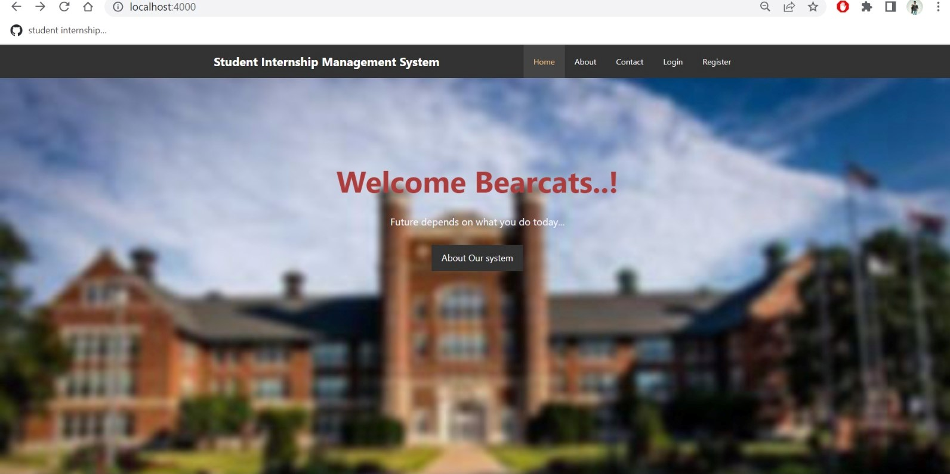
Application Home page
Fig 1 : Application Home Page
Presenter: Venkata Shashank Chennu
Page: 6

Slide 7
Application Home page Cont’d
In home page, we have given buttons like About, Contact,Register and Login.
About : In About tab, we have given information regarding the benefits of the internship and also about our application.
Contact : In contact tab, we have provided a complaint form where users can raise their issues by filling.
Login : In login tab, users can login their account to use their benefits of the application.
Register : In register tab, users can create an account according to their role like company, student and administrator.
Presenter: VenkataShashank Chennu
Page :7

Slide 8
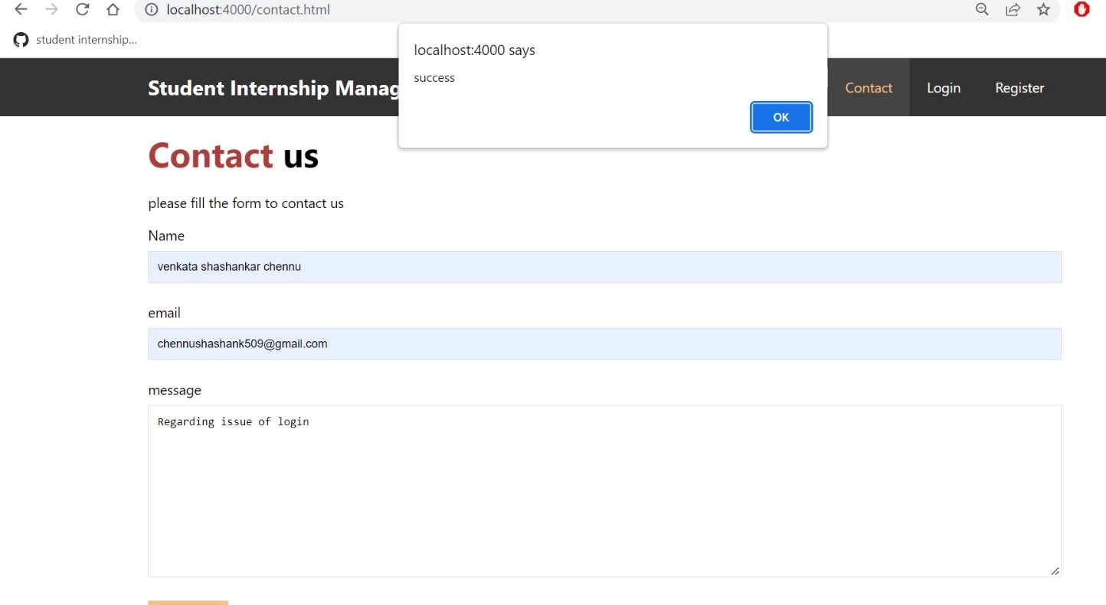
Contact Tab
In contact Tab, if users faces any issue with the application or any other they can raise it by filling out the form and submitting.
Fig2 : Contact Tab
Presenter: VenkataShashank Chennu
Page :8

Slide 9
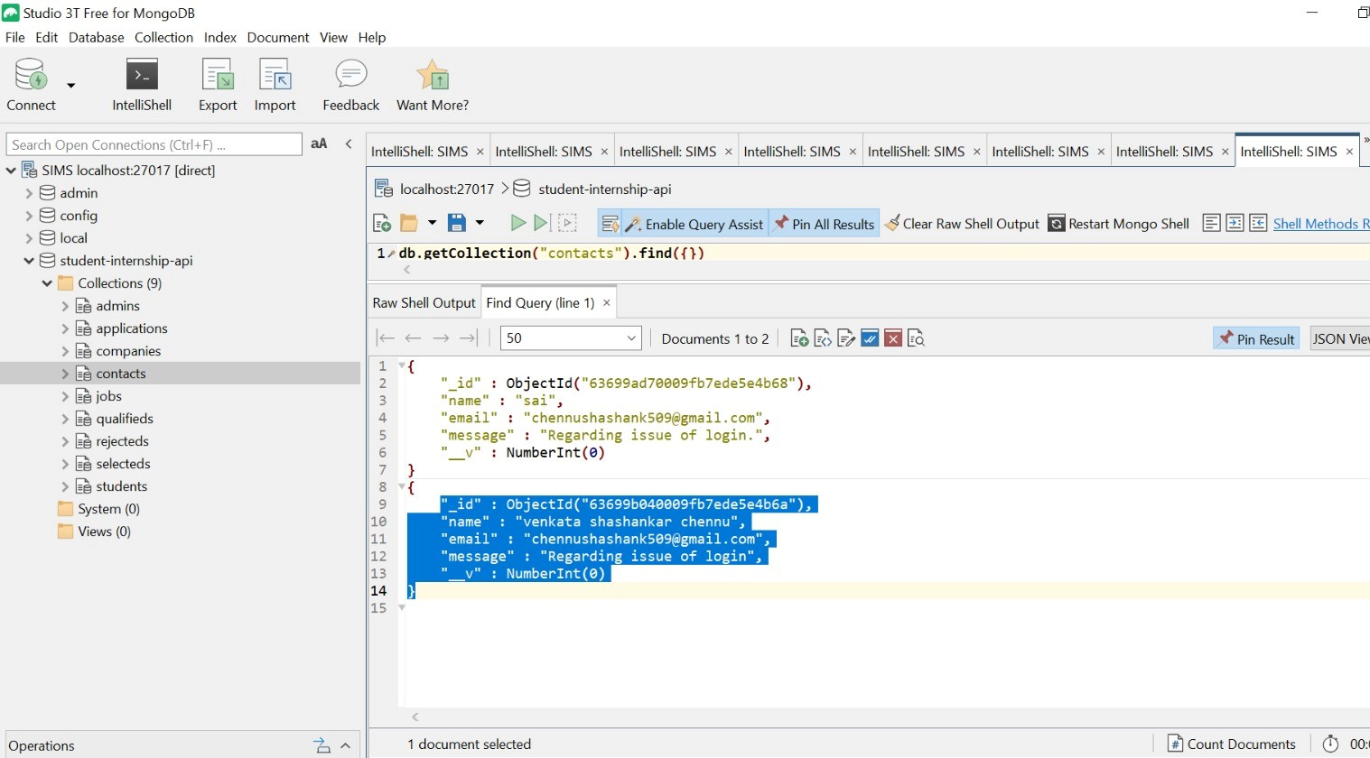
Contact Tab Cont’d
Fig3 : Database storage of Contact Tab
Presenter: VenkataShashank Chennu
Page :9

Slide 10
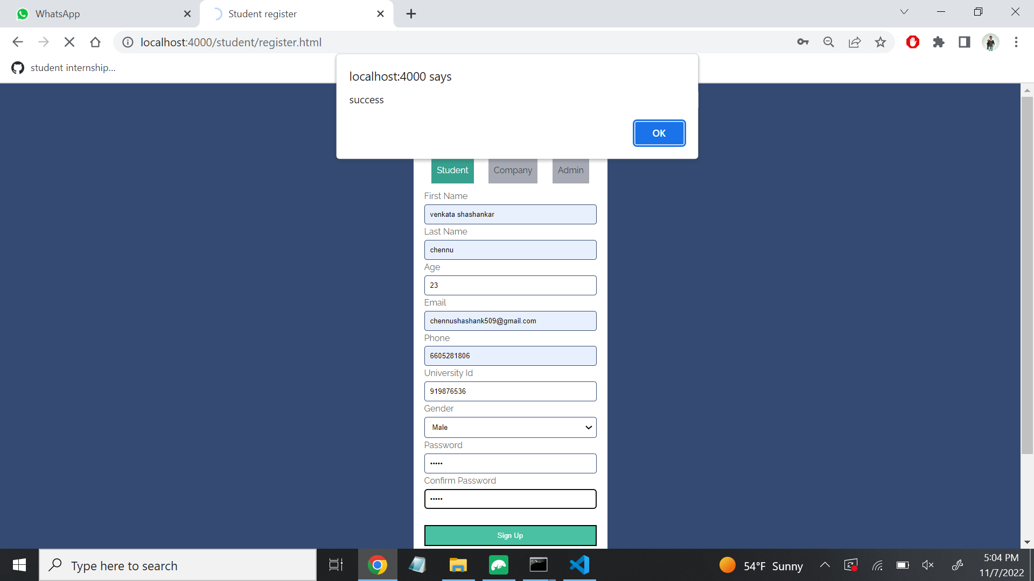
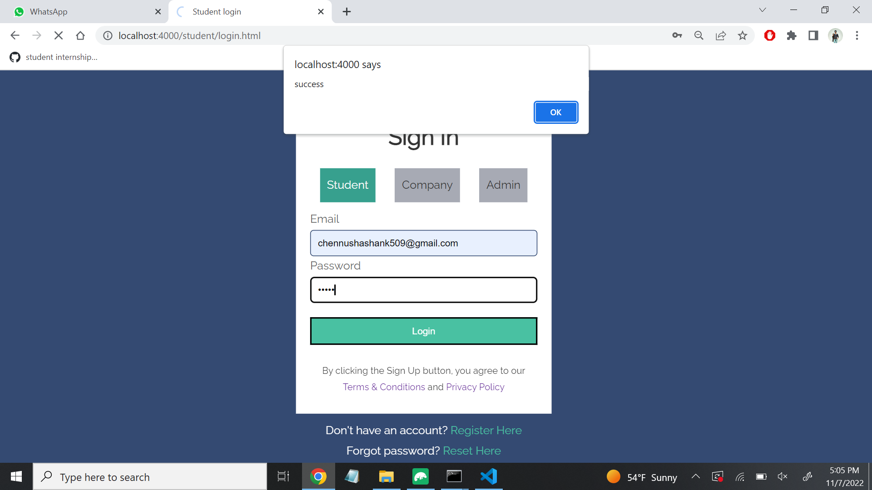
Student Registration and Login Page
Students can register with the minimum requirements
We store this data using MongoDB in Robot3T
Fig4 : Student Registration
Fig 5 : Student Login
Presenter: Parimalla Pokuri
Page: 10

Slide 11
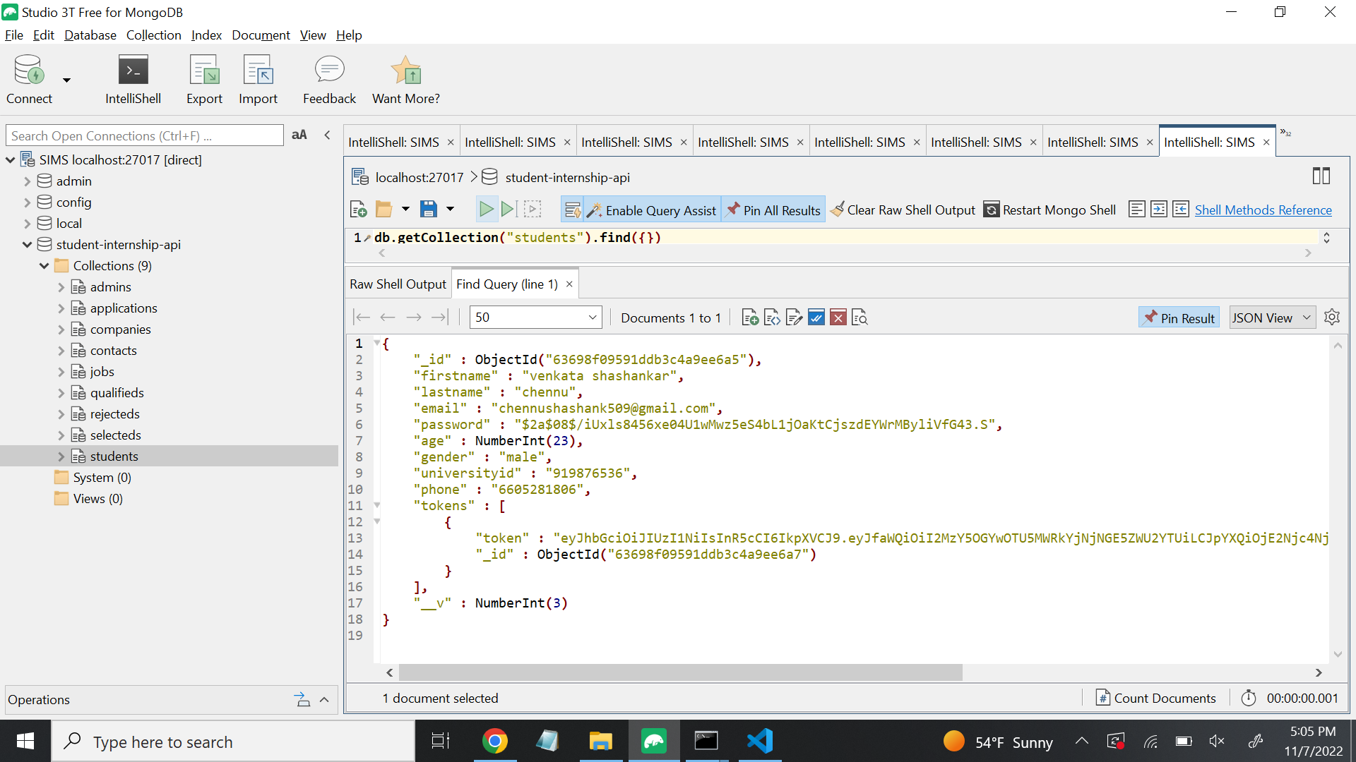
Student Registration Database Storage
We store this data in the form of Database Collections by using MongoDB
Fig 6: Student Registration Stored in Database
Presenter: Parimalla Pokuri
Page: 11

Slide 12
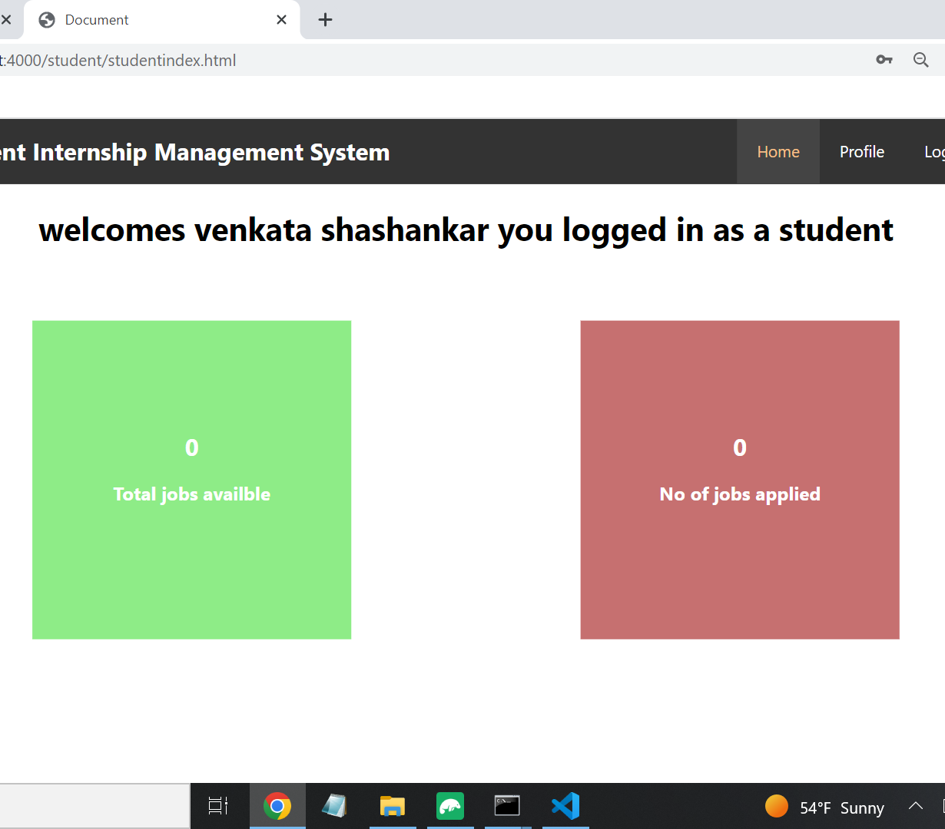
Dashboard of Student Page
Once student login to the portal, he/she could able to see this page.
As it contains two blocks one is Total jobs available and another is total no.of jobs applied
Fig 7: Before Posting Jobs
Presenter: Parimalla Pokuri
Page: 12

Slide 13
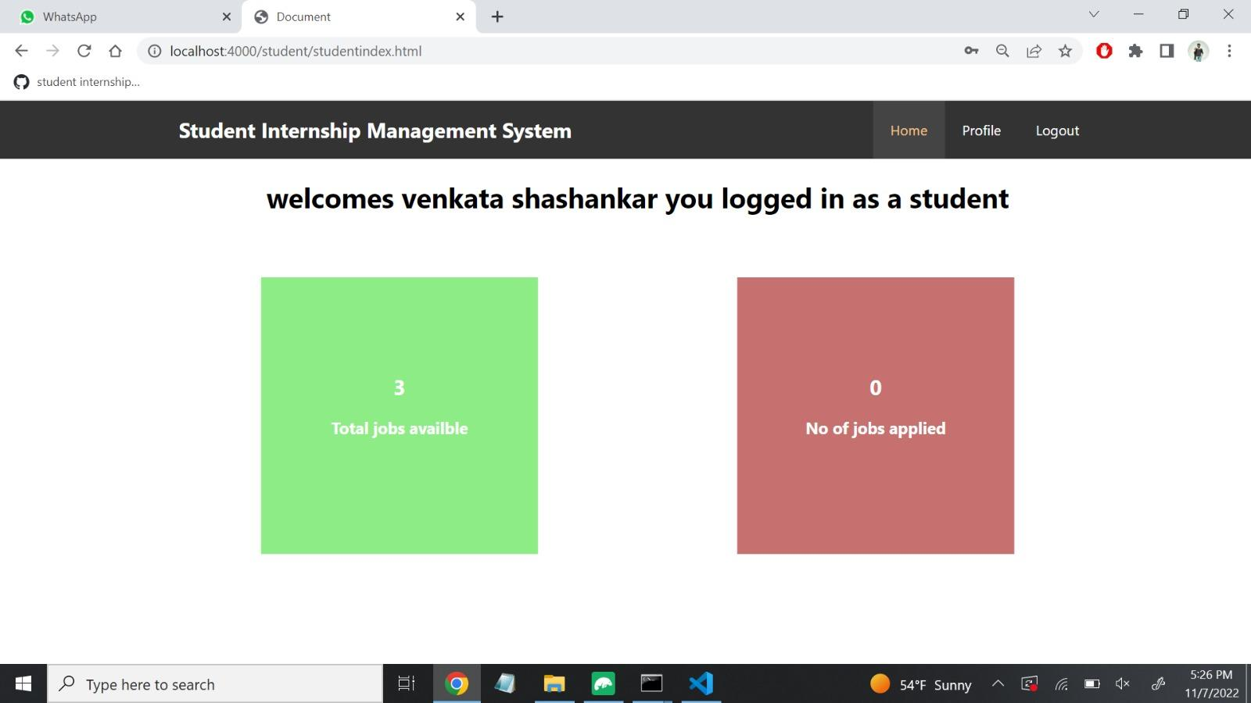
Dashboard of Student Page
When company post jobs, those posted jobs will display here in the total jobs available block.
Fig 8: After Posting Jobs
Presenter: Parimalla Pokuri
Page: 13

Slide 14
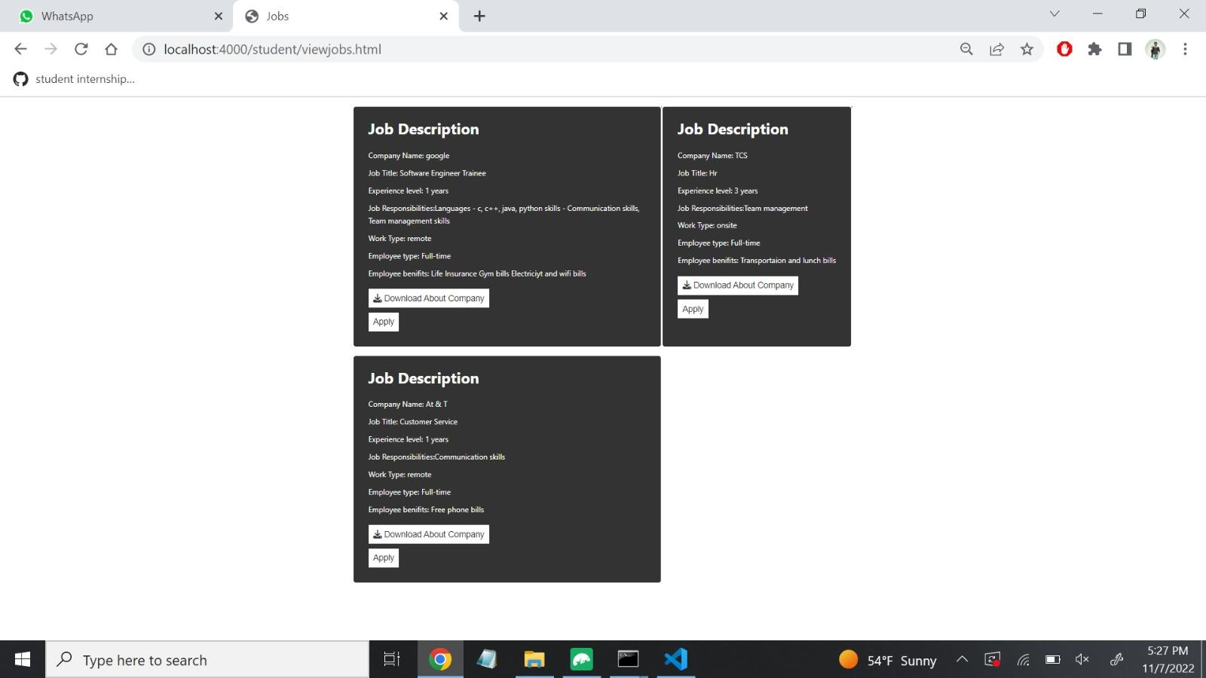
Total jobs available page
In this page, Total number of jobs posted by the companies will display here .
From here onwards, Students can able apply for the jobs
Fig 9: Jobs Available page
Presenter: Parimalla Pokuri
Page: 14

Slide 15
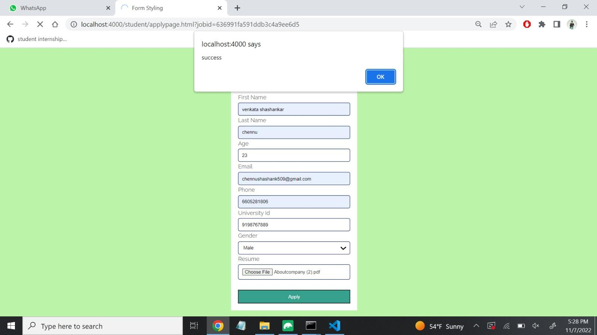
Applying for job page
Students can able to fill all the required details for applying the job and also can upload their resume which should of document format.
Fig 10: Apply page
Presenter: Parimalla Pokuri
Page: 15

Slide 16
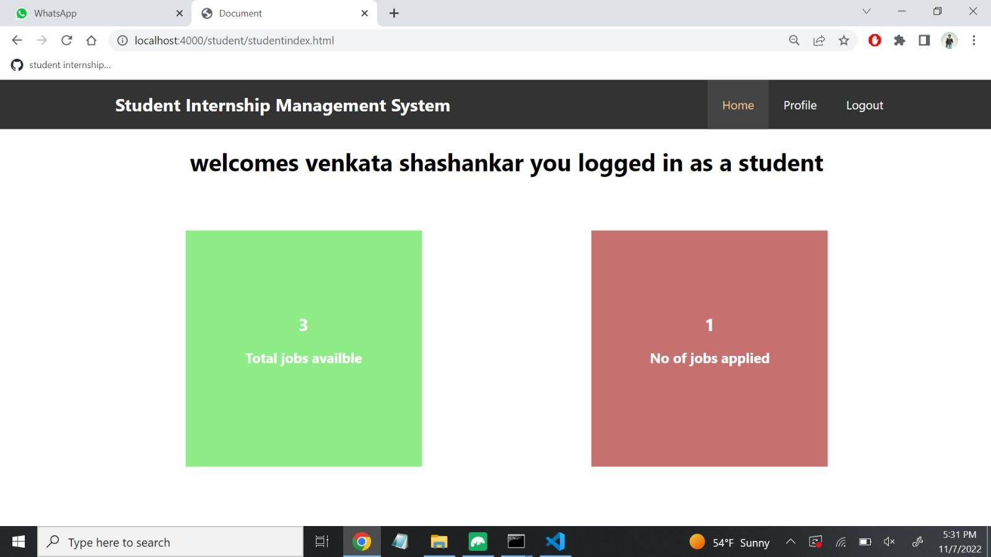
Updated Dashboard
Once a student applied for a job, here number of jobs applied column will display the total number of jobs applied by the student.
Fig 11 : Dashboards after applying for a job
Presenter: Parimalla Pokuri
Page: 16

Slide 17
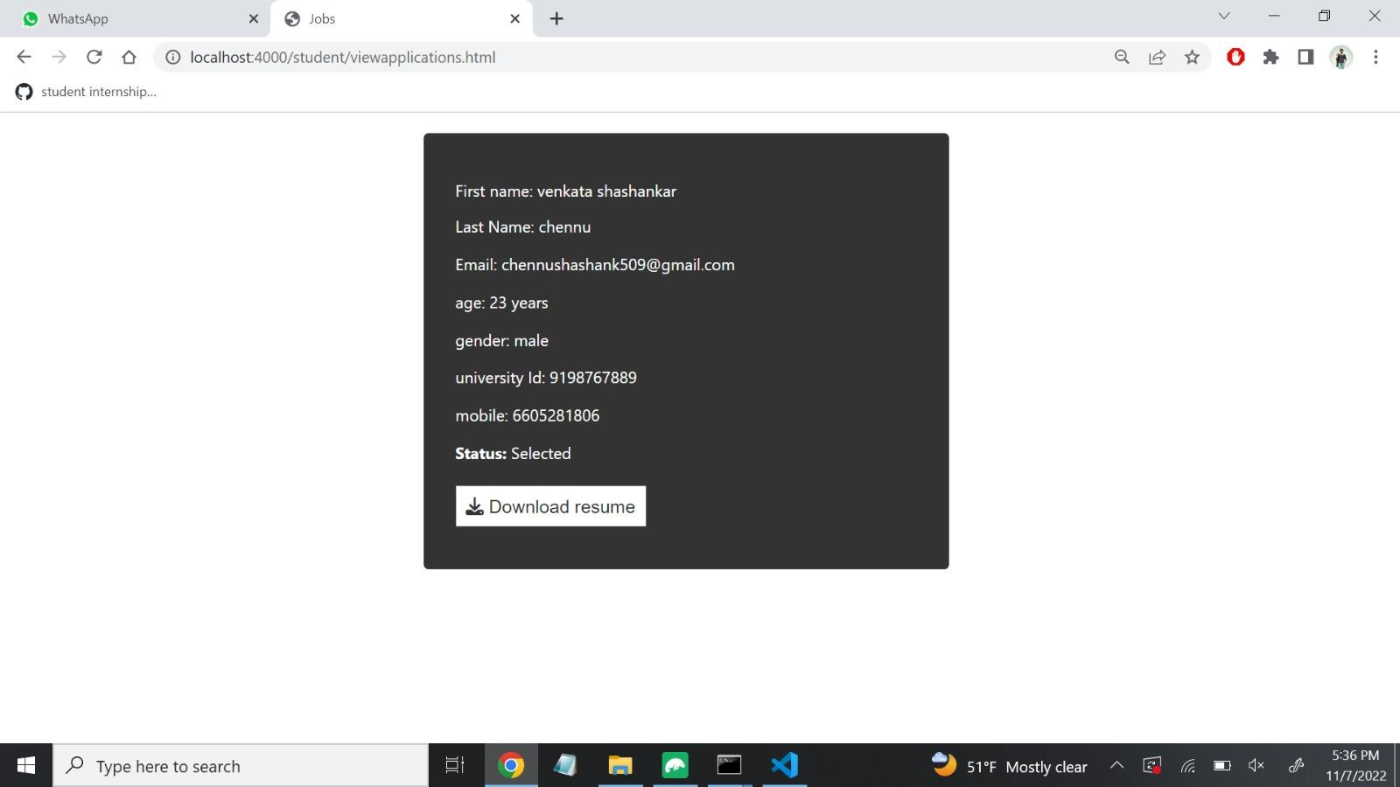
Status of Application
It will display the application status as the application is rejected or accepted or Qualified for the next round
Fig 12 :Applied Jobs Page
Presenter: Parimalla Pokuri
Page: 17

Slide 18
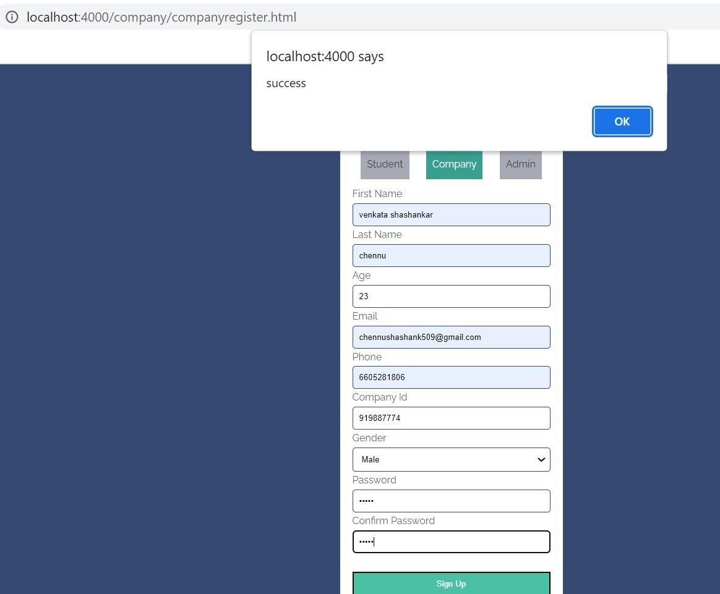
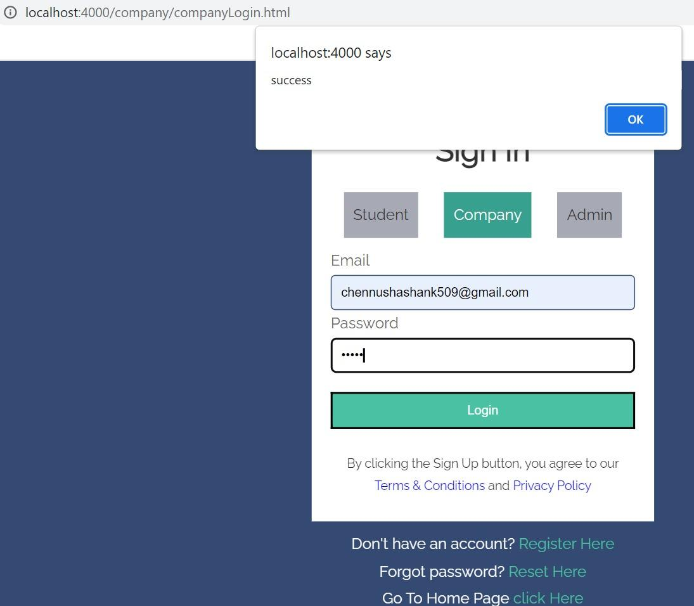
Company Registration and Login pages
Fig 13: Registration and Login page of company
Presenter:Anusha Poreddy
Page: 18

Slide 19
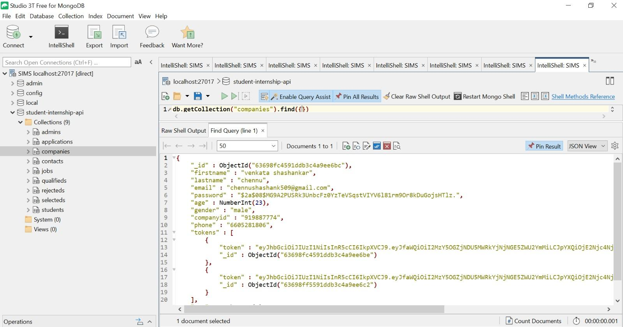
Company Registration Database storage
Fig 14 : Registration and login page data storage
Presenter:Anusha Poreddy
Page: 19

Slide 20
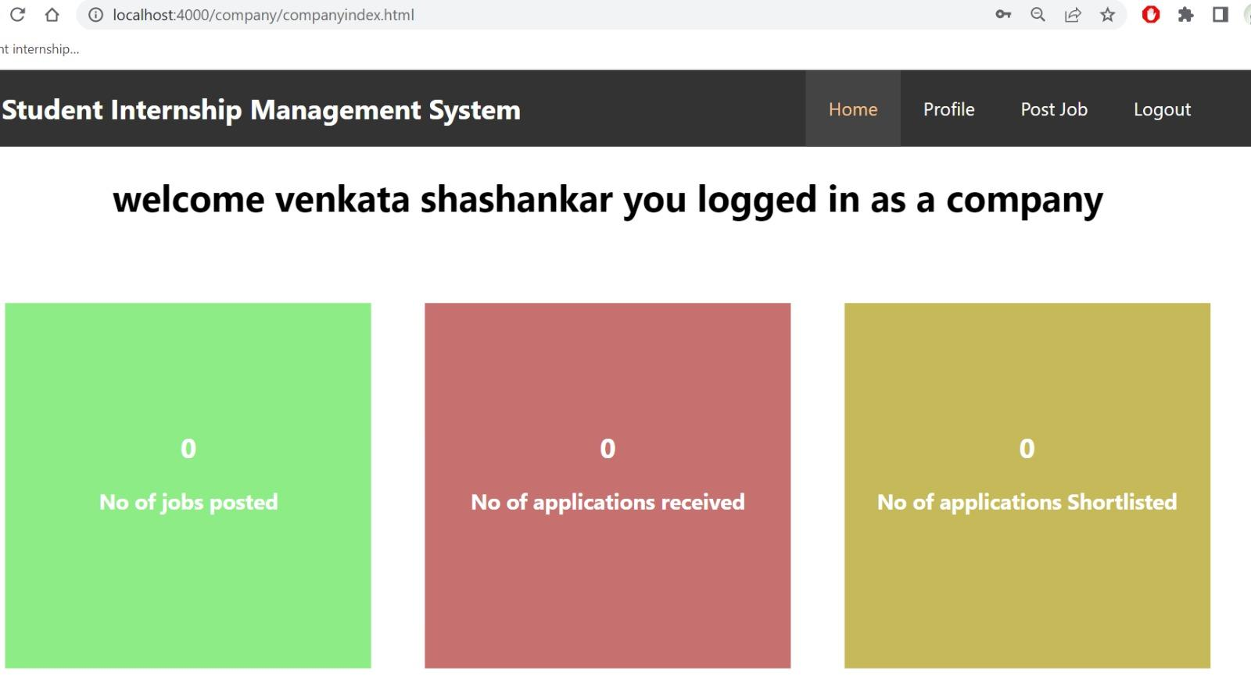
Company Dashboard
Here is the company dashboard having three fields.
Number of jobs posted
Number of applications received
Number of applications shortlisted
Fig 15: Company Dashboard
Presenter:Anusha Poreddy
Page: 20

Slide 21
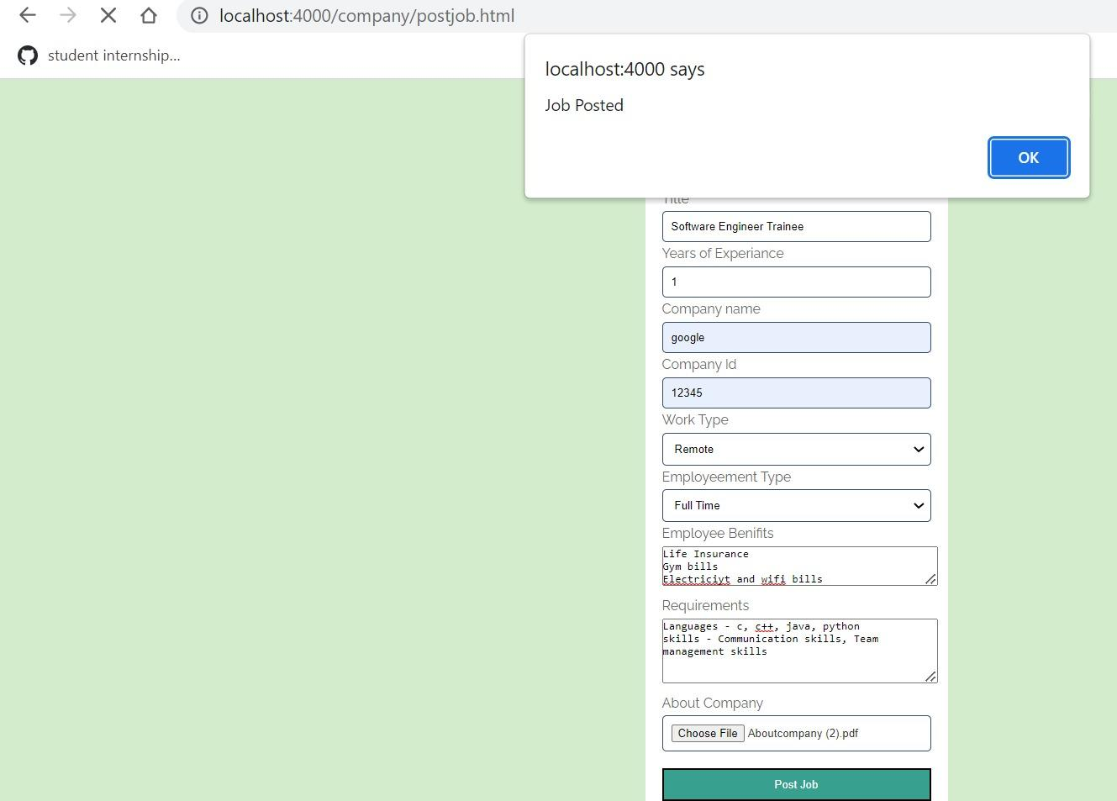
Company Job Post
Here is the company job posts page
If company want to post a job need to fill all the requirements including job post, Year of experience, company id, benefits, requirements and work type
Fig 16 : Job posted by a company
Presenter: Anusha Poreddy
Page: 21

Slide 22
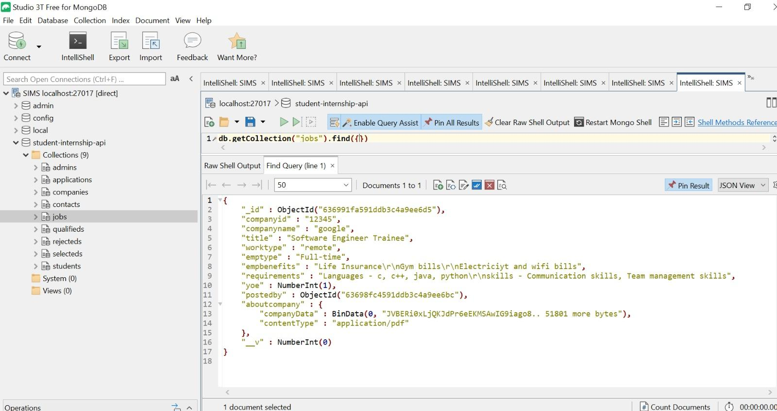
Company Job Post Data Storage
This figure shows how data is stored in a database about the job post that are posted by a company.
Fig 17 : Data storage of job post by company
Presenter:Anusha Poreddy
Page: 22

Slide 23
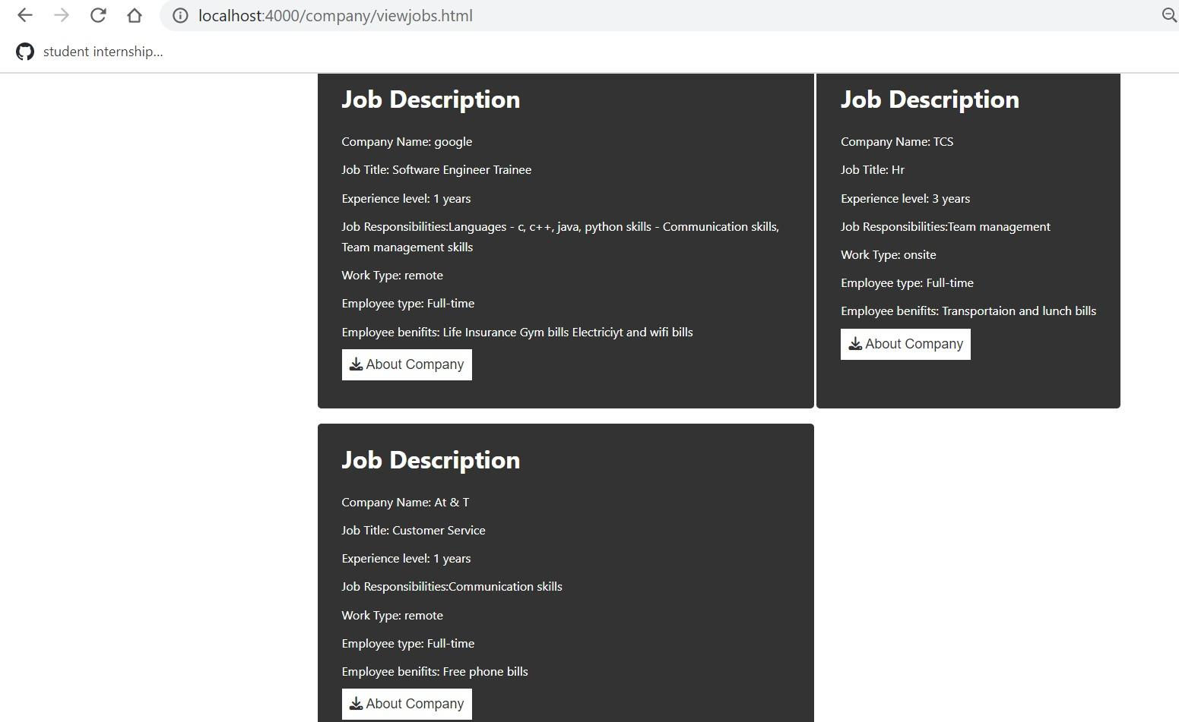
Multiple Job Post Grid Format
If company posts n number of job it displayed in grid format.
This figure display grid format of three jobs that are posted by a company.
Fig 18 : Multiple job post by company in grid format
Presenter:Anusha Poreddy
Page: 23

Slide 24
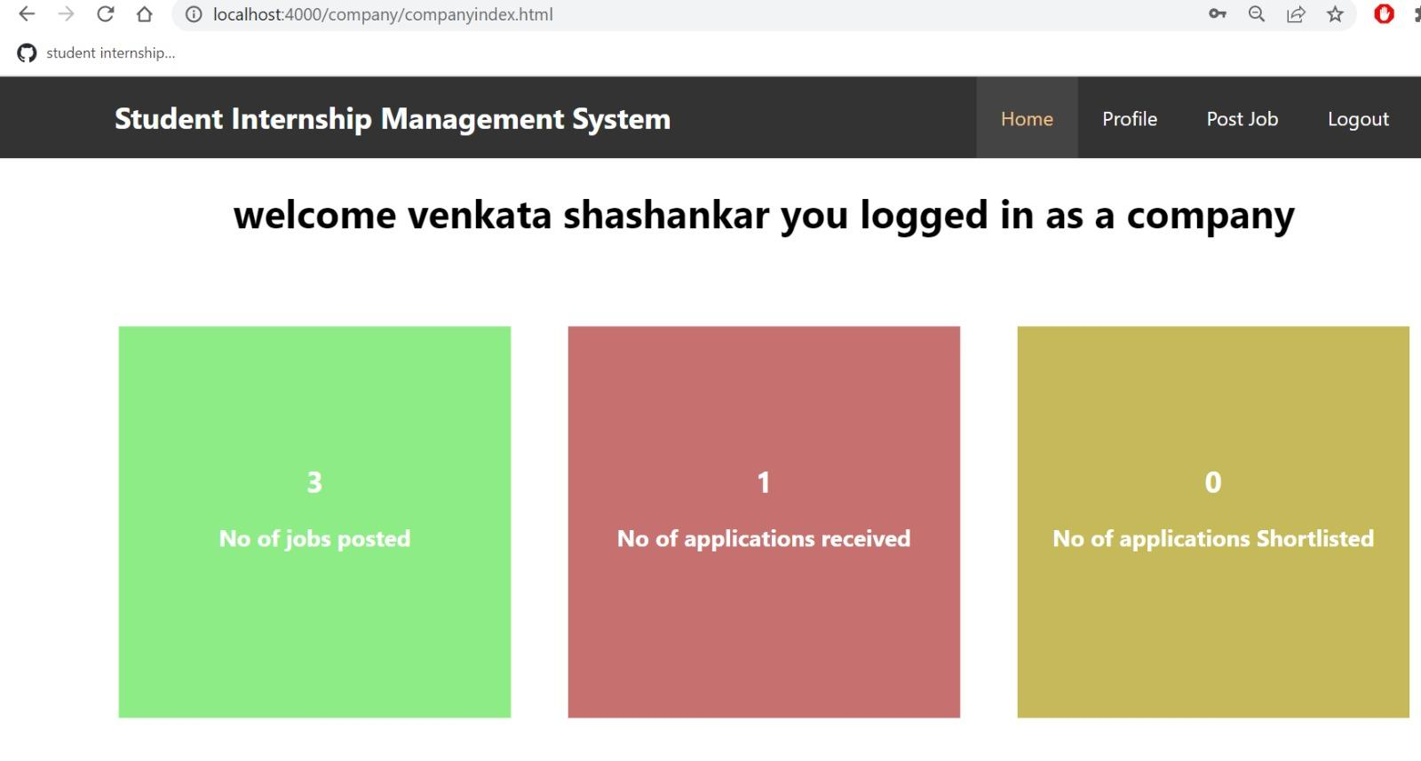
Company Dashboard Dynamic Data
No.of jobs posted fields showing the three jobs as company posted three jobs.
No.of applications received display one as one student applied for particular job.
Fig 19 : Dynamic data of company dashboard
Presenter : Anusha Poreddy
Page:24

Slide 25
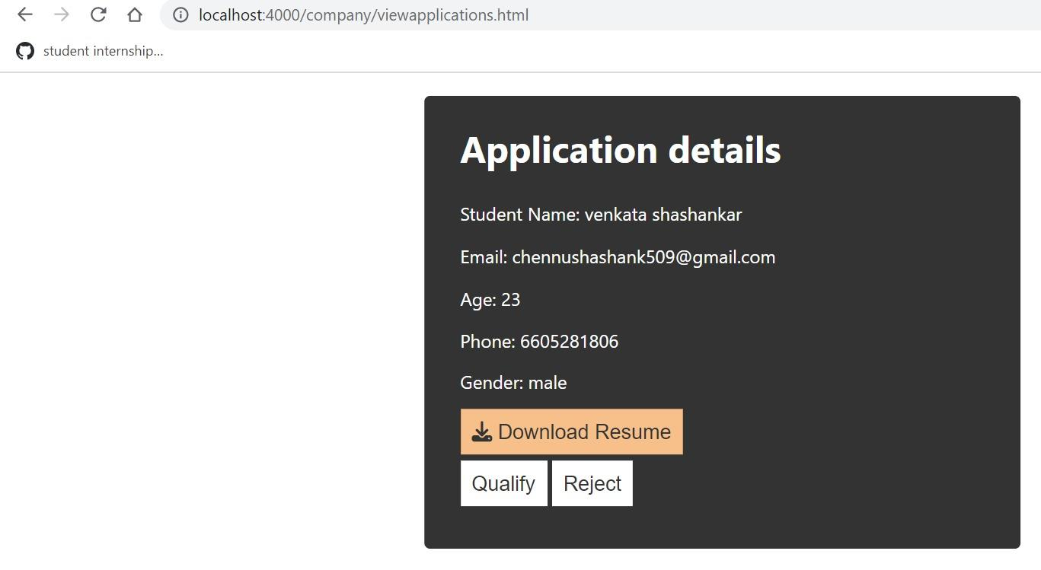
Application Details
Here is the figure that display the application details of the student that are applied by student
Company have access to qualify or reject the application.
Fig 20 : Application details
Presenter : Anusha Poreddy
Page: 25

Slide 26
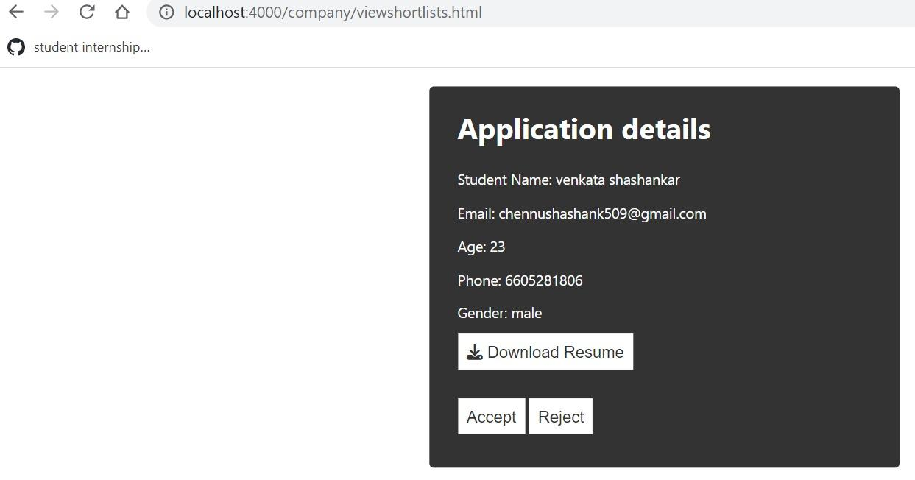
Application Details Cont’d
This figure shows the application details once company qualify the student application they have access to accept or reject the applications
Fig 21: Application details
Presenter : Anusha Poreddy
Page: 26

Slide 27
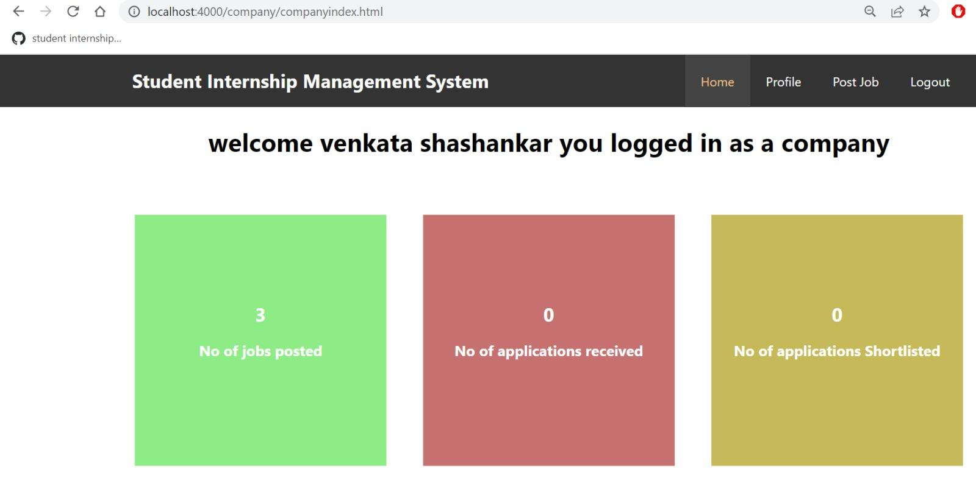
Application Details Cont’d
After accept the student application the No.of shortlisted field returns to static data.
Student receive status notification whether accept or reject.
Fig 22 : Application details in company dashboard
Presenter: Anusha Poreddy
Page: 27

Slide 28
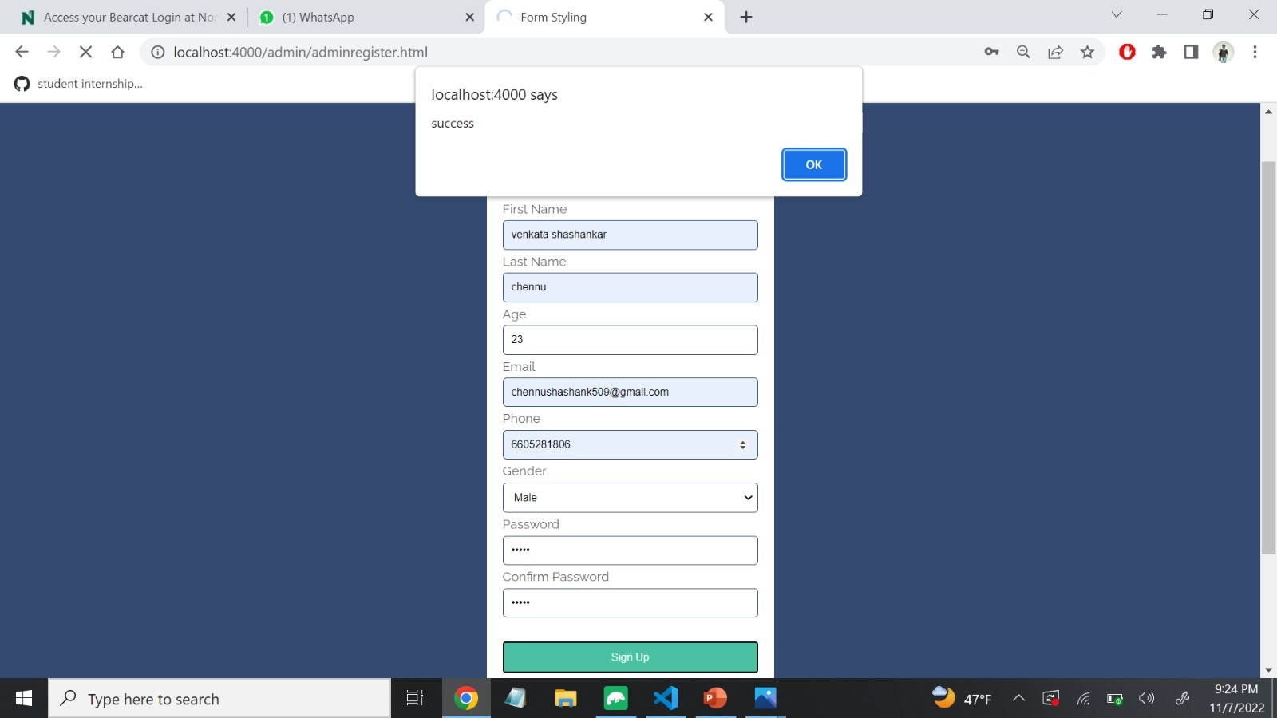
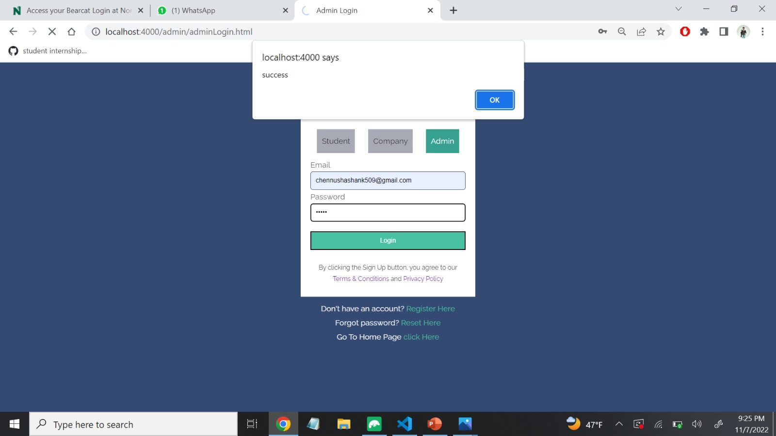
Admin Registration and Login
Here is the pictures for admin registration and login.
And the server is running at localhost:4000 and it pop up registration and login are succesfull.
Fig 23: Admin Registration page
Fig 24: Admin Login page
Presenter: Manikanta Arumilli
Page: 28

Slide 29

Admin Database
Here this picture displays the data of registration page in database using Mongodb.
Fig 25 : Admin Registration details stored in Database
Presenter: Manikanta Arumilli
Page: 29

Slide 30
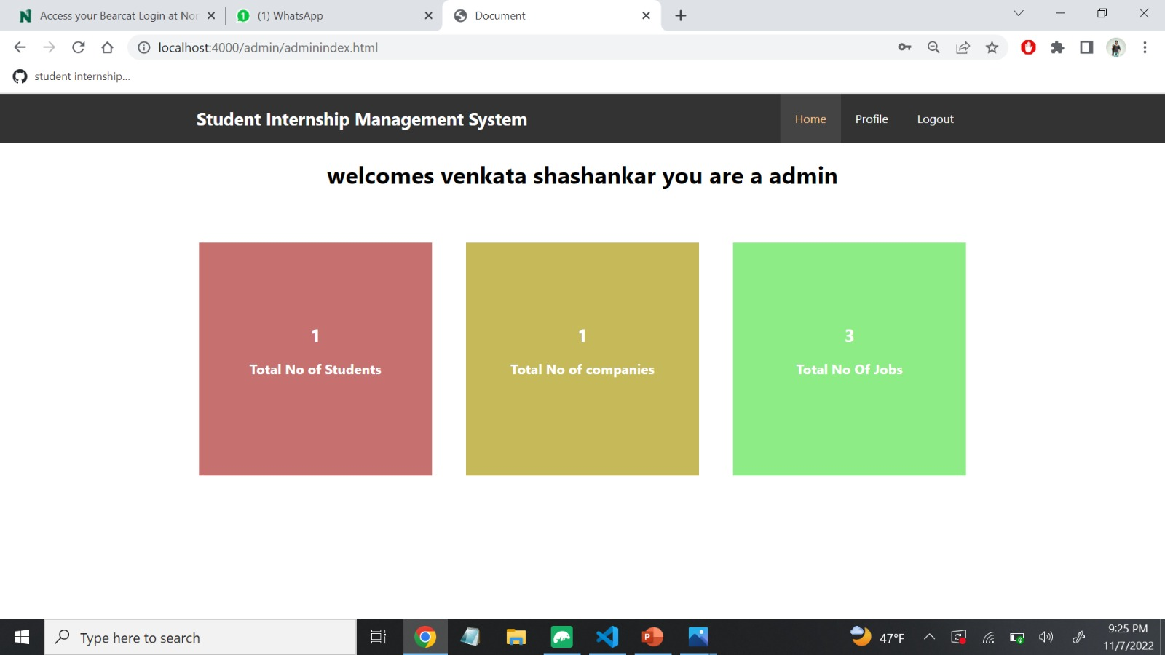
Dashboard
Here is the dashboard for admin page.
Admin have access to see the total number of jobs applied by the student and total number of jobs posted by the company and also have access to accept or reject the fake data.
Fig 26 : Application details in Admin dashboard
Presenter: Manikanta Arumilli
Page:30

Slide 31
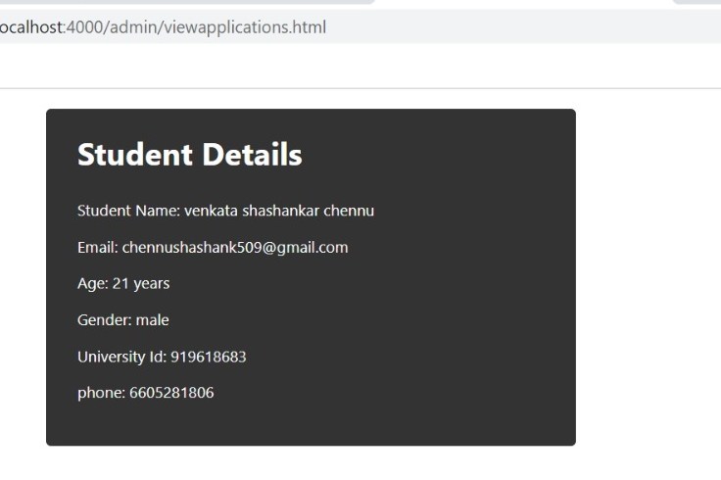
Total Students in Admin page
Here is the figure that
displays the applied
student details.
Fig 27: Student Details in Admin Dashboard
Presenter: Manikanta Arumilli
Page: 31

Slide 32
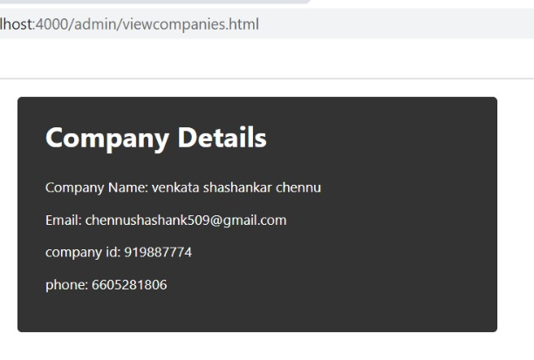
Total Company in Admin page
Here is the figure that
displays the
company details.
Fig 28 : Company Details in Admin Dashboard
Presenter: Manikanta Arumilli
Page: 32

Slide 33
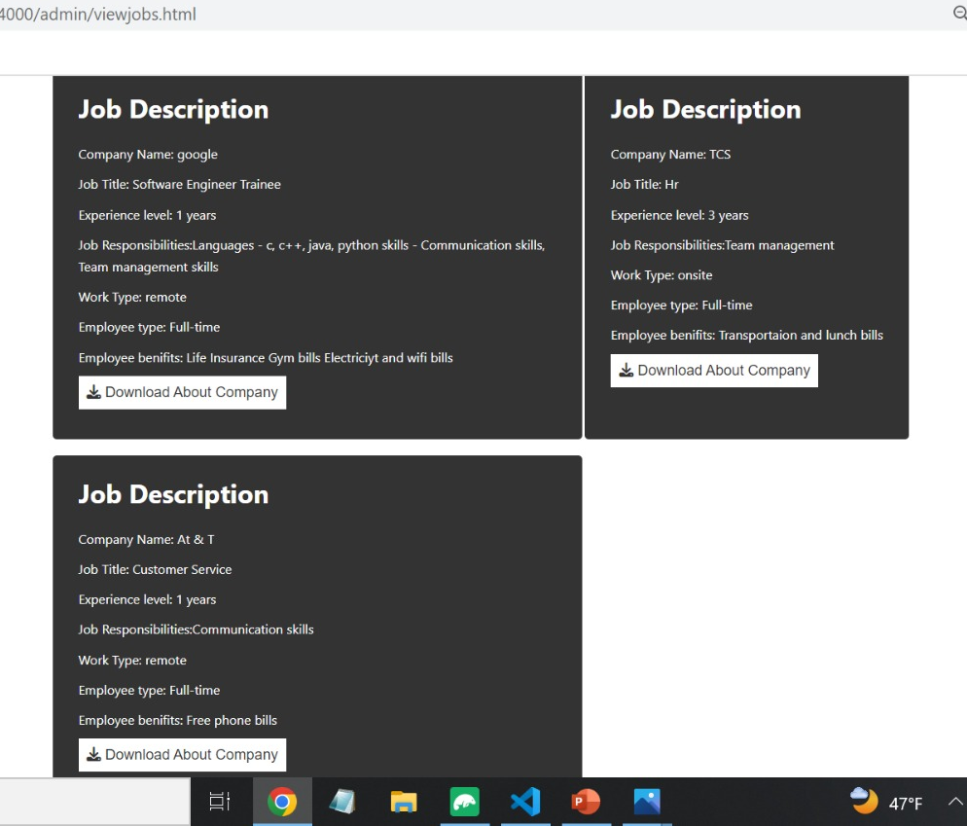
Total Jobs Available in Admin page
If company posts n number of Jobs it is displayed in grid format.
This figure display grid format of three jobs that are posted by a company.
Admin can view all three Jobs.
Fig 29 : Jobs Details in Admin Dashboard
Presenter: Manikanta Arumilli
Page: 33

Slide 34
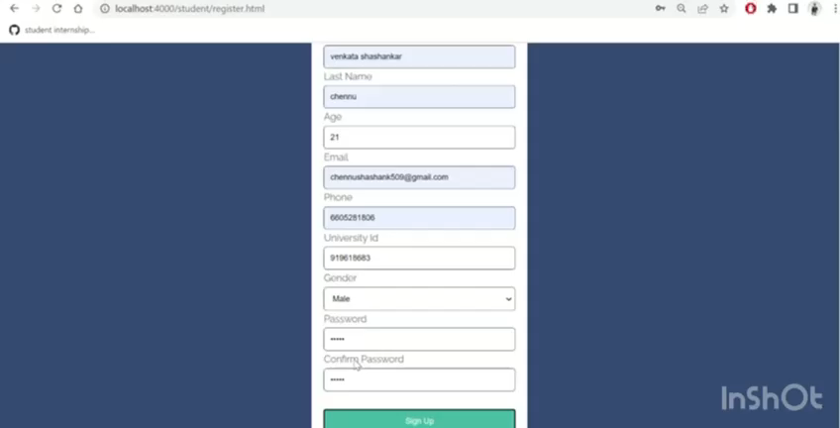
DEMO
Video 1 : Demo of our web application
Presenter : Sai Krishna Gadde
Page :34

Slide 35
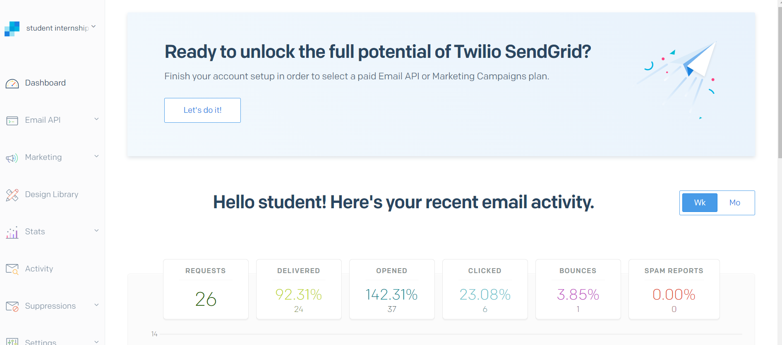
Mail Validation
To validate the mails and reset the passwords we have used a third-party application called Sendgrid.
Which is able to send 100 mails per Day at free of cost.
Fig 30 : Statistics of sendgrid portal
Presenter: Sai Krishna Gadde
Page :35

Slide 36
Advantages of Application
User friendly interface.
Easily accessible.
Easy modification.
Provide best security.
Time saving.
Presenter: Manikanta Arumilli
Page: 36

Slide 37
Future Implementations
Password Restriction.
Contact Information.
Profile Update For Student, Company, Admin Pages..
We need to add the actions buttons for admin for accept or reject the data.
Presenter: Manikanta Arumillic
Page: 37

Slide 38
Lessons Learnt
We are new to this technology and usage of Robot 3T. At the start we faced issues for connecting the data.
We faced a challenge while learning NODE JS using in backend. It is like a daily challenge while we integrate new improvement in project.
While we were working on the company page, How to advertise jobs is a big task. Even though we have posted in company page, Job Details were not displaying in Student page. Later we overcome that one too.
Presenter: Manikanta Arumilli
Page: 38

Slide 39
Summary
The main objective of our project is to provide Jobs or Internships for the Students through the help of the website, Company can able to accept Student’s Job applications.
As we are working on this project, We have learnt so many technical things and our perspective towards project has been Improved.
Presenter: Manikanta Arumilli
Page: 39

Slide 40
References
Node.js:
https://www.tutorialspoint.com/nodejs/nodejs_introduction.htm
MongoDB:
https://www.tutorialspoint.com/mongodb/index.htm
Github link:
https://github.com/anushaporeddy030697/student_internship_management
Presenter: Manikanta Arumilli
Page: 40

Slide 41

Presenter: Parimalla Pokuri
Page: 35

Slide 42
TEAM - 04
TEAM-04
VENKATA SHASHANKAR CHENNU
SAI KRISHNA GADEE
MANIKANTA ARUMILLI
ANUSHA POREDDY
SHASHANKAR CHENNU
PARIMALLA POKURI
SAI KRISHNA GADDE
MANIKANTA ARUMILLI
Mentor & Client
Dr. CHANDRA MOULI MADHAV KOTTETI
ANUSHA POREDDY
PARIMALLA POKURI
Dr.CHANDRA MOULI KOTTETI
Client & Mentor
Page: 2
Page: 42

Slide 43
Title: Student Internship Management System
Team Members:
Venkata Shashankar Chennu
Parimalla Pokuri
Anusha Poreddy
Sai Krishna Gadde
Manikanta Arumilli
Client & Mentor: Dr. Chandra Mouli Kotteti
Sec No: 03
Team No: 04
Presenter: Venkata Shashank Chennu
Page: 1

